Slide 1
ECE480
Team 8: Maximum Power Point Tracker
Daniel Chen
Yue Guo
Luis Kalaff
Jacob Mills
Brenton Sirowatka
Notes:
Louis

Slide 2
Our Team
Name | Responsibility
Daniel Chen | Presentation Preparation
Yue Guo | Lab Coordinator
Luis Kalaff | Project Management
Jacob Mills | Project Webmaster
Brenton Sirowatka | Documentation Preparation
Notes:
Louis

Slide 3
Presentation Objectives
Introduction
Background
Real World Applications
Available Solutions
Project Objectives
Customer Expectations
Design Approach
Design Stages
Implementation
Microcontroller
Voltage and Current Sensing
Testing Strategies
Project Management
Technical Responsibilities
Gantt Chart
Fast Diagram
Notes:
Louis

Slide 4
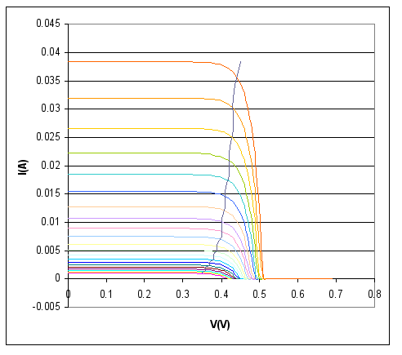
Background
What is a Maximum Power Point Tracker?
  Maximizes power from solar cells
  The device finds the point on the I-V curve where Maximum Power is given.
  The MPPT matches the low voltage of the solar array to the high voltage of the battery
Notes:
Jacob

Slide 5
Background
There are eight types of methods for tracking the maximum power point:
Perturb and Observe
Incremental Conductance
Current Sweep
Constant Voltage
Open Circuit Voltage
Short Circuit Current
Temperature
Temperature Parametric
We decided to use the Perturb and Observe method.
Notes:
Jacob

Slide 6
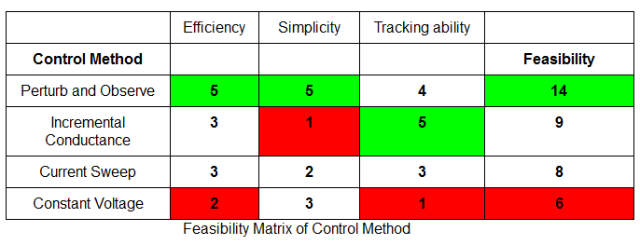
Background
Notes:
Jacob

Slide 7
Background
Perturb and Observe Method:
Increases input voltage continuously
Current begins to drop as voltage increases
Once current drops to far the voltage is then lowered back to the point where maximum power is achieved.
The device then oscillates around the maximum power point.
Notes:
Jacob

Slide 8
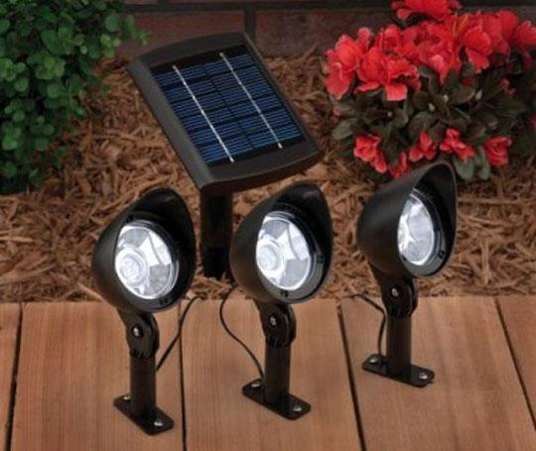
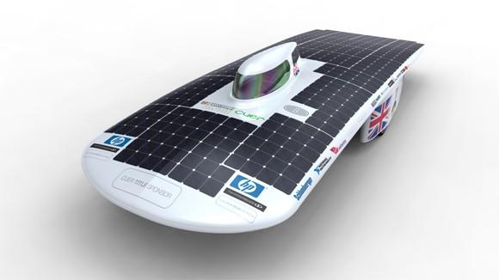
Real World Applications
MPPTs are used in any product that contains a solar cell.
  Cars, batteries, buses, landscaping, pools, boats, etc.
Also used in optical power transmission systems
  Method for replacing copper wiring with fiber optic cables.
  power is transmitted into light and sent through fiber optic cable.
  Cell converts light back to electricity and sufficient voltage is acquired using MPPT.
Notes:
Jacob

Slide 9
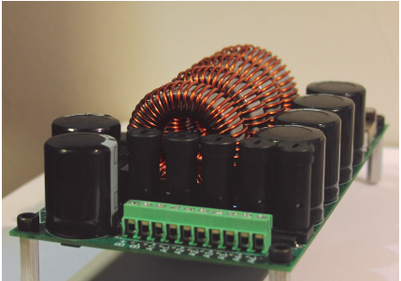
Available Solution
Previously the Solar Car Racing Team used the Dilithium Power Systems ‘Photon Quad MPPT.’
  Boost Ratio: 1 to 14
  contains 160V battery
  Used CAN based communication
Features 4 independent channels and is optimized for several kinds of solar arrays.
Notes:
Jacob

Slide 10
Customer Expectations
Greater than 95% efficiency
One channel
Input voltage 20 to 60 Volts
Output voltage ~110 Volts
Withstand 6 Amps of current
Single PCB
Notes:
Brenton

Slide 11
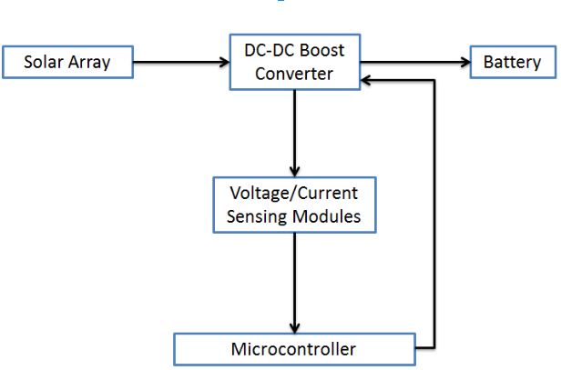
Design Approach
Notes:
Brenton

Slide 12
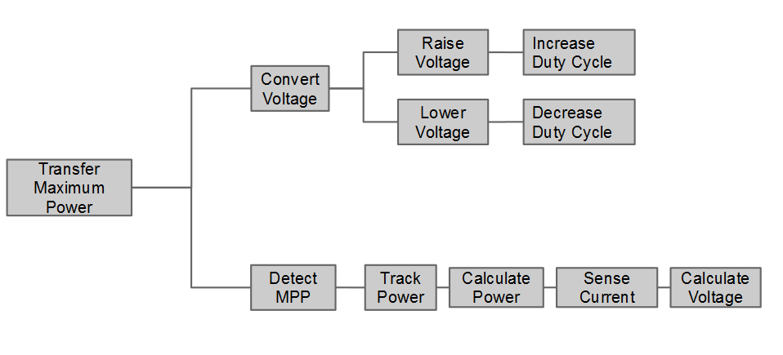
FAST Diagram
Notes:
Brenton

Slide 13
Design Stages
DC-DC Boost Converter
Microcontroller Tracking
PCB Layout
Notes:
Brenton

Slide 14
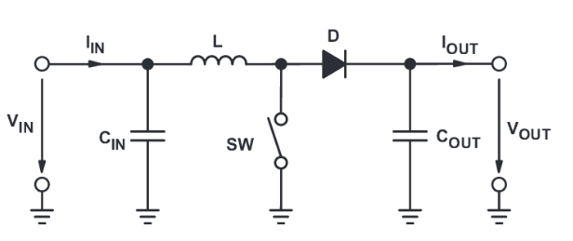
DC-DC Boost Converter
Convert the lower voltage from the solar array to match the higher voltage of the battery
Battery
Solar Array
Notes:
Brenton

Slide 15
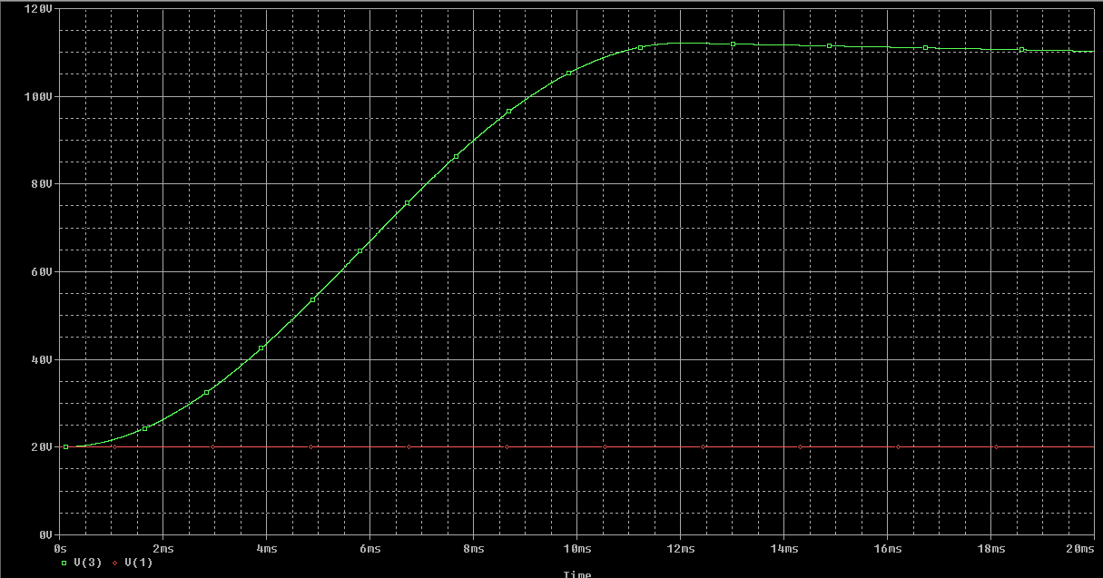
PSpice DC-DC Boost Simulation
Notes:
Brenton

Slide 16
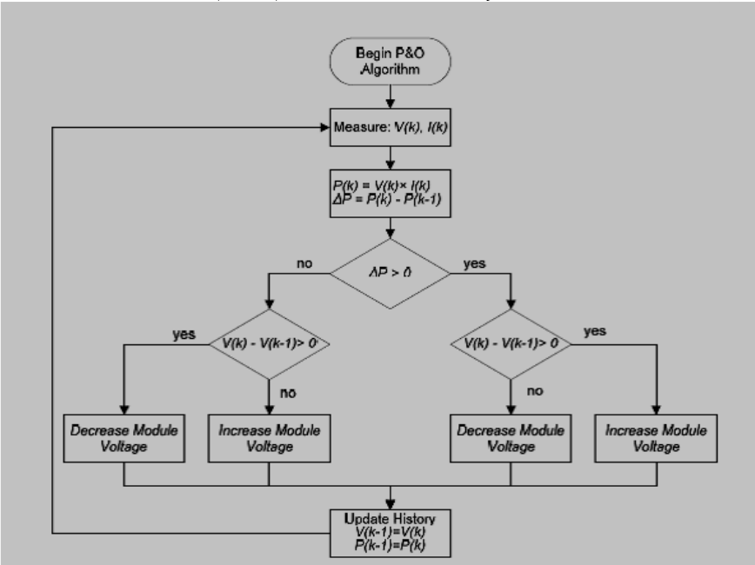
Microcontroller Tracking
An algorithm is implemented to find the maximum powerpoint by adjusting the voltage slightly. The team chose to implemented the “perturb and observe” method for maximum power tracking.
Notes:
Yue

Slide 17
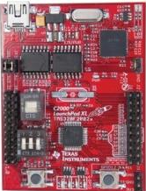
Microcontroller
Using C2000 Piccolo launchpad
12bit ADC, 8 PWM channels
60MHz Frequency
Notes:
Yue

Slide 18
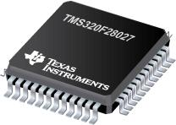
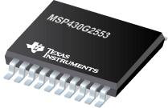
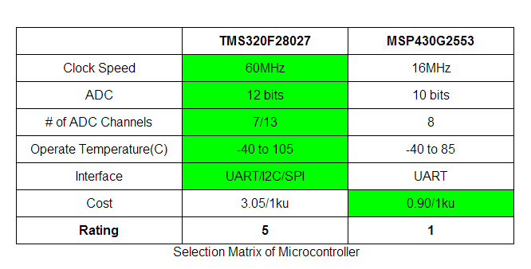
Microcontroller
Notes:
Yue

Slide 19
Voltage & Current Sensing
Via Microcontroller
Voltage Divider/Current Resistor Sensing
Notes:
Daniel

Slide 20
Sensing Implementation
Microcontroller
Utilize analog-digital converter
Input constraints
  Need to drop the output voltage from the Solar Array
Notes:
Daniel

Slide 21
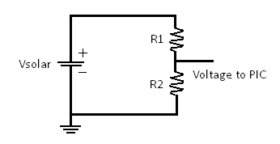
Sensing Implementation
Voltage Divider Sensor
Vout = Vin*(R2/(R1+R2))
Power loss
Non Constant Input
Alternative
Vin
Vout
Notes:
Daniel

Slide 22
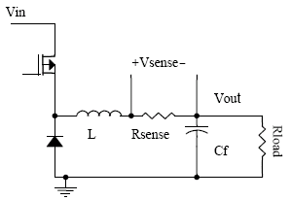
Sensing Implementation
Current Resistor Sensor
Low ohm Resistor
Less power loss
Notes:
Daniel

Slide 23
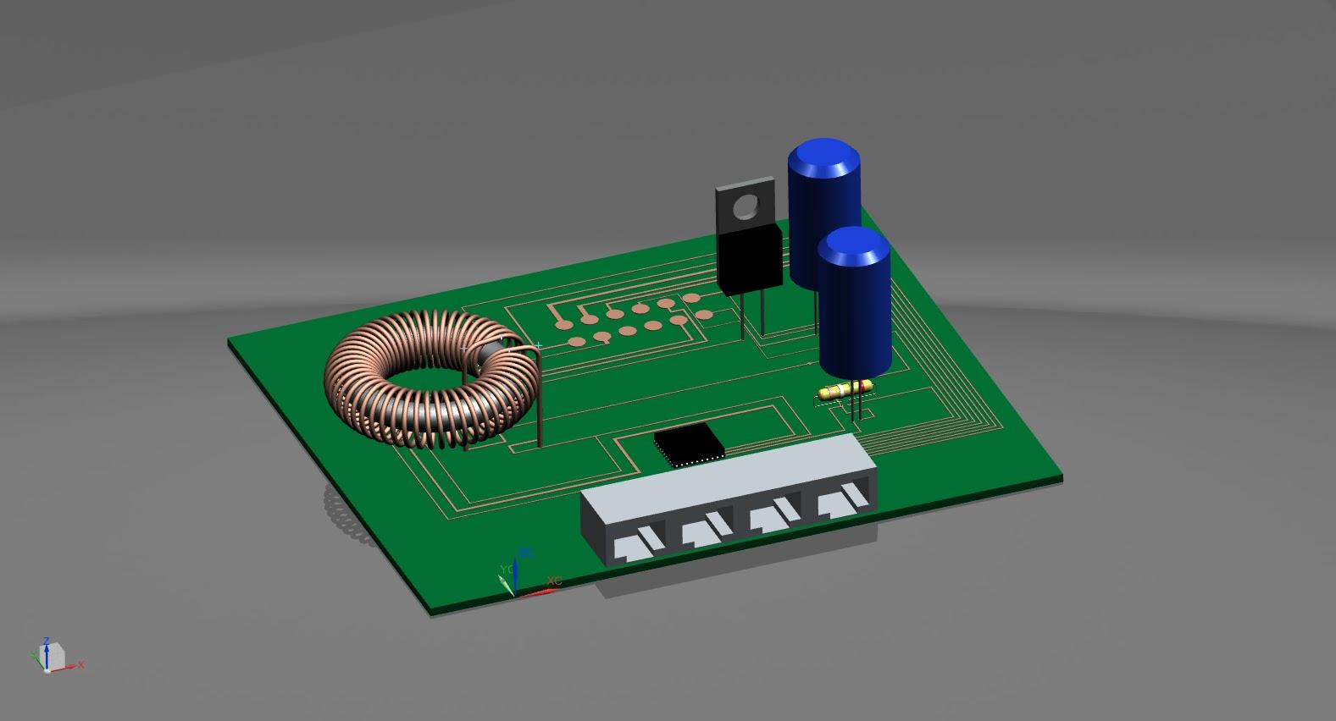
PCB Board
Combine the analog and the digital part of our design into one single PCB board
Notes:
Daniel

Slide 24
Testing Strategies
Use a smaller power supply and lower voltages
  eg. Lab Bench Power supply
Limited current for safety
Notes:
Daniel

Slide 25
Technical Responsibilities
Name | Responsibility 1 | Responsibility 2 | Responsibility 3
 | Selection & Ordering | Calculation & Simulations | Prototyping & Refinement
Daniel Chen | Resistor | Risk Analysis Data | Building/Testing Prototype
Yue Guo | Magnetic Core | PCB Layout | Building/Testing Prototype
Luis Kalaff | Microcontroller | Labview DC-DC Booster | Building/Testing Prototype
Jacob Mills | Diode | Inductor Core & Windings | Programming Microcontroller
Brenton Sirowatka | Capacitor | PSpice DC-DC Circuit | Programming Microcontroller
Notes:
Louis

Slide 26
Budget
Design Stages | Cost
DC-DC Boost Converter | $40
Microcontroller | $20
PCB Layout | $60
Miscellaneous | $20
Notes:
Louis

Slide 27
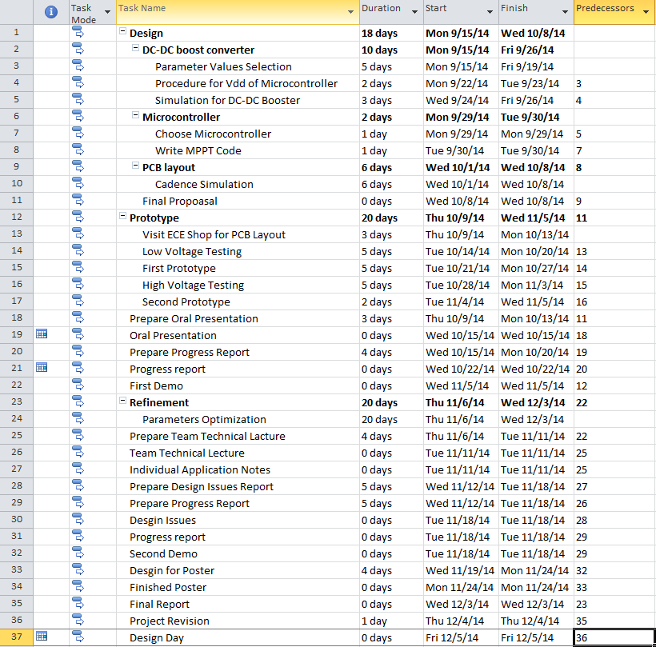
Gantt Chart Tasks
Notes:
Louis

Slide 28
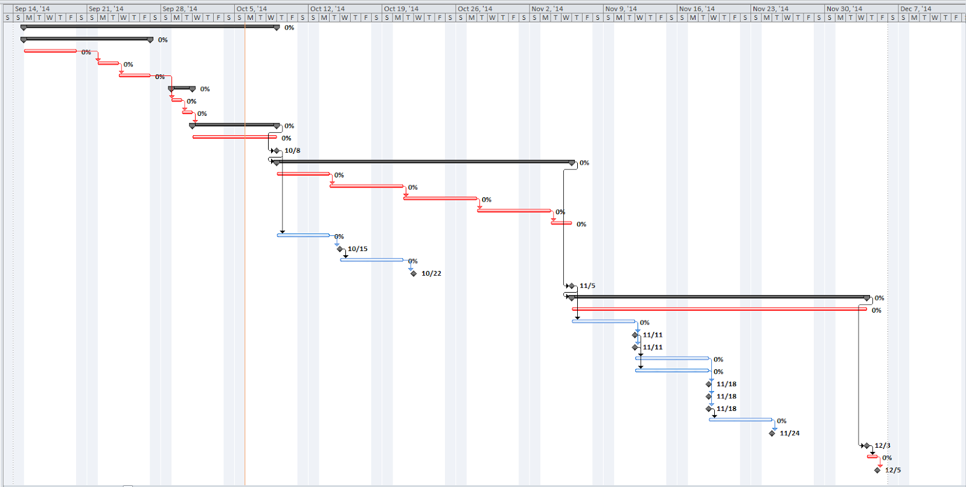
Gantt Chart
Refinement
Design
Prototype
Notes:
Louis

Slide 29
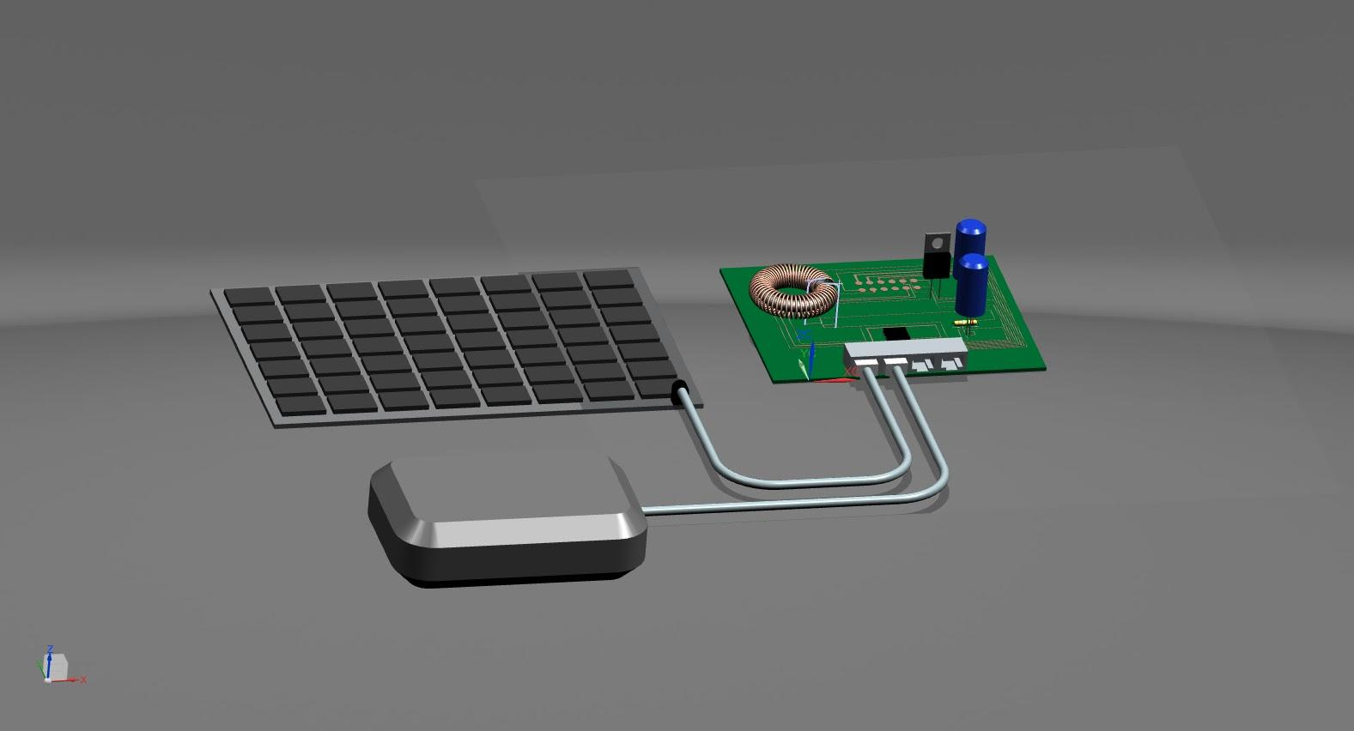
Final Design Blueprint
Notes:
Yue

Slide 30
Special Thanks to
Everyone in the MSU Solar Car Team
  Ian Grosh
  Steve Zajac
  Scott O’Connor
Dr. Bingsen Wang (Faculty Advisor)
Brian,Gregg, and Roxanne (ECE Shop)
Notes:
Louis

Slide 31
Question?
Notes:
Everybody

Slide 32
Thank You
Notes:
Everybody

